Slide 1

Project Title Design & Development Ecommerce Website
Minor Project - I
CS- 508
Problem Statement: Develop a recommendation system for an e-commerce website that retrieves product listings and prices from various platforms like Amazon, Flipkart, and Myntra, displaying them on the user's search. Additionally, implement graphical authentication for enhanced security during user login.
Project Group Number: 39
Group Member Details:Nidhi rani (0187CS211108)
Navlesh kumar (0187CS211106)
Manish kumar (0187CS211096)
Praveen pandey (0187CS21124)
Guide Details: Bhavna Soni

Slide 2
Idea/Approach Details
Abstract:
Our website is a cutting-edge platform revolutionizing online shopping by seamlessly integrating leading e-commerce APIs for real-time product listings and prices. In addition, we pioneer enhanced security measures through graphical authentication, empowering users to create personalized authentication patterns using specific images. This innovative approach ensures both seamless shopping experiences and robust protection against unauthorized access, elevating usability and security to unprecedented levels."
Describe your idea Solution/Prototype here:
Create a recommendation system integrating APIs from leading e-commerce platforms to showcase product listings and prices directly on the user's search. Simultaneously, incorporate graphical authentication as an additional security layer for user login. Users will select specific images and create personalized patterns for authentication, enhancing both the usability and security of the platform. This approach aims to offer users a seamless shopping experience while ensuring robust protection against unauthorized access.
Describe your Technology stack here:
Front-End Technologies: HTML, CSS, JavaScript.
Database: Mongo DB
Backend-Technology: Python with flask

Slide 3
Project Requirements
Functional Requirements
Non Functional Requirements
User Registration and Authentication.
User-friendly search for clothes of men’s and women’s collection.
Easy-to-use to buy .
Secure storage of user data and payment information.
Protection against common web security threats.
Instant booking confirmations and reservation details.
Performance
Availability and Reliability
Usability and Accessibility
Maintainability
Monitoring and Logging
Response Time

Slide 4
Project Requirements
Hardware and Software requirements (Developer)
Hardware and Software requirements (Client)
Hardware Requirements:
Intel core i5 Processor
At least 4GB RAM
Storage:
Software Requirements:
Visual Studio Code
Java Development Kit
Java Servlet Container
Web Browsers(Google Chrome, Firefox)
Operating System(Windows)
Database Software(MySQL-10.4.2)
Hardware Requirements:
Intel core i3 Processor
At least 4GB RAM
System Storage: 256GB HDD, 256GB SSD
Software Requirements:
Internet Security
Web Browsers

Slide 5
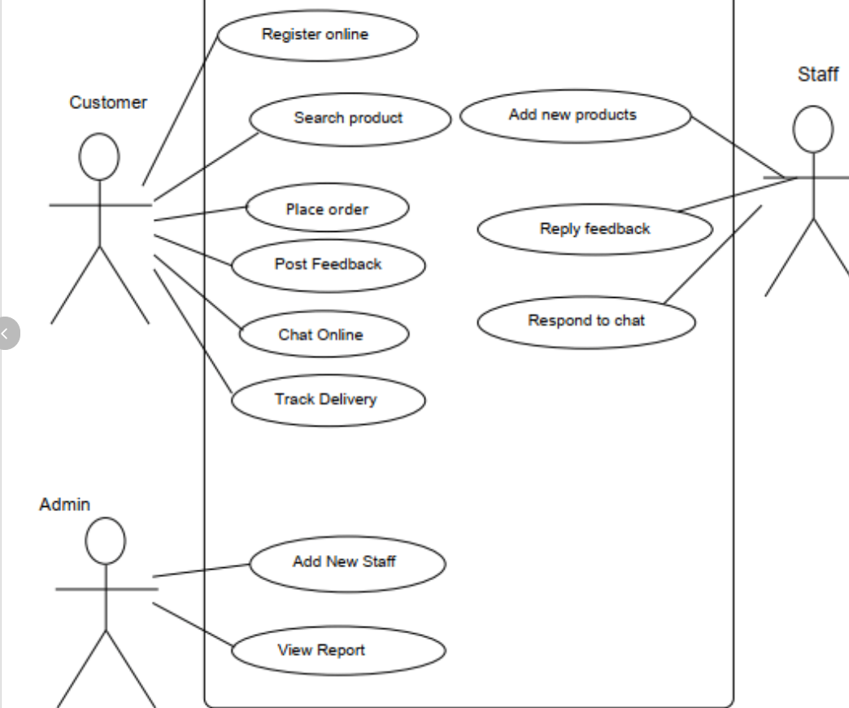
Design
Describe your Use Cases here
Describe your Dependencies / Show stopper here
Dependencies
Web Development Tools: Essential for creating the user interface and functionality.
Data Base System: To store and manage user data and test results.-Internet Connectivity: Essential for platform accessibility.
Responsive Design: Ensure the website is responsive and accessible on various devices, including smartphones, tablets, and desktops.

Slide 6
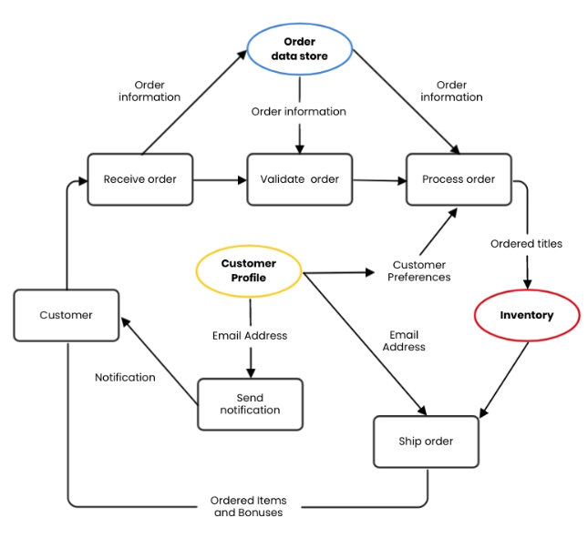
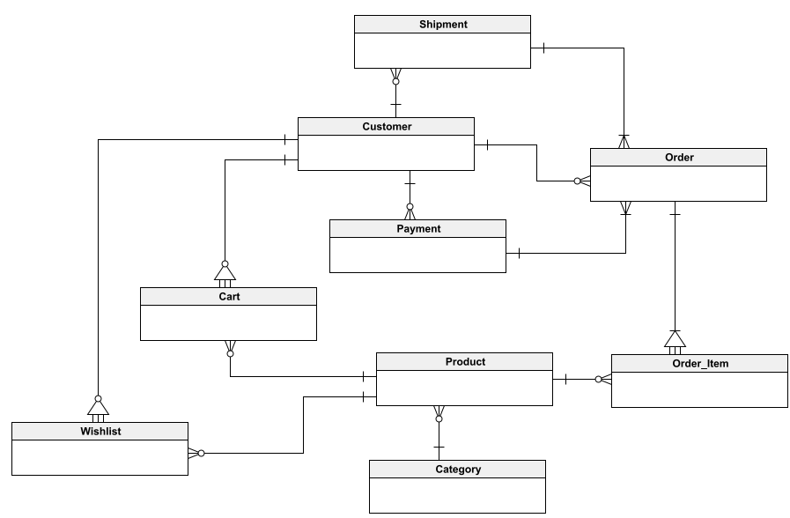
Design
Describe data flow diagram here(if applicable)
Describe your ER Diagram here(if applicable)
6

Slide 7
Deployment Details
Describe Deployment Details here
Web Hosting: Choose a reliable web hosting service that can handle your website's traffic and performance requirements.
Web Server: Set up a web server to host your website’s code. Popular choices include Apache. Configure the server to handle incoming HTTP requests.
Database: Choose a database management system (DBMS) to store and manage restaurant data, user profiles, reservations, and more. Common options are Mongo DB.
Frontend: Design and develop the user interface (UI) and user experience (UX) of your website. Use HTML, CSS, and JavaScript for frontend development.
Back-End: Implement the server-side logic for handling user registrations, restaurant listings, reservations, and user authentication. Use programming languages like python with flask.

Slide 8
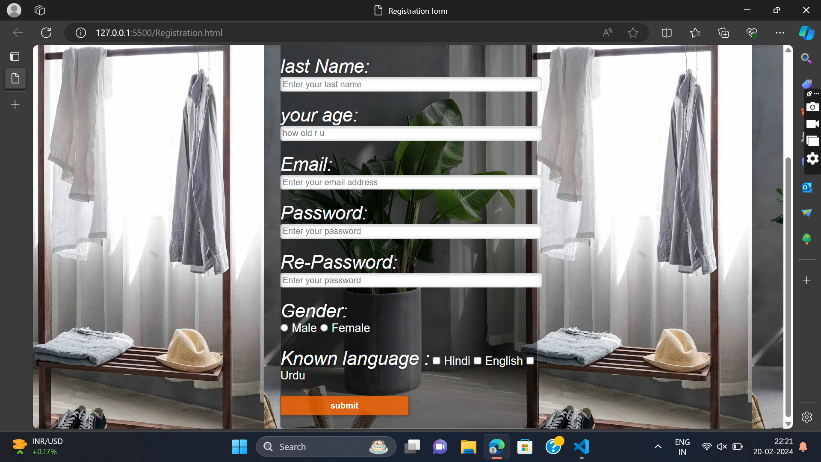
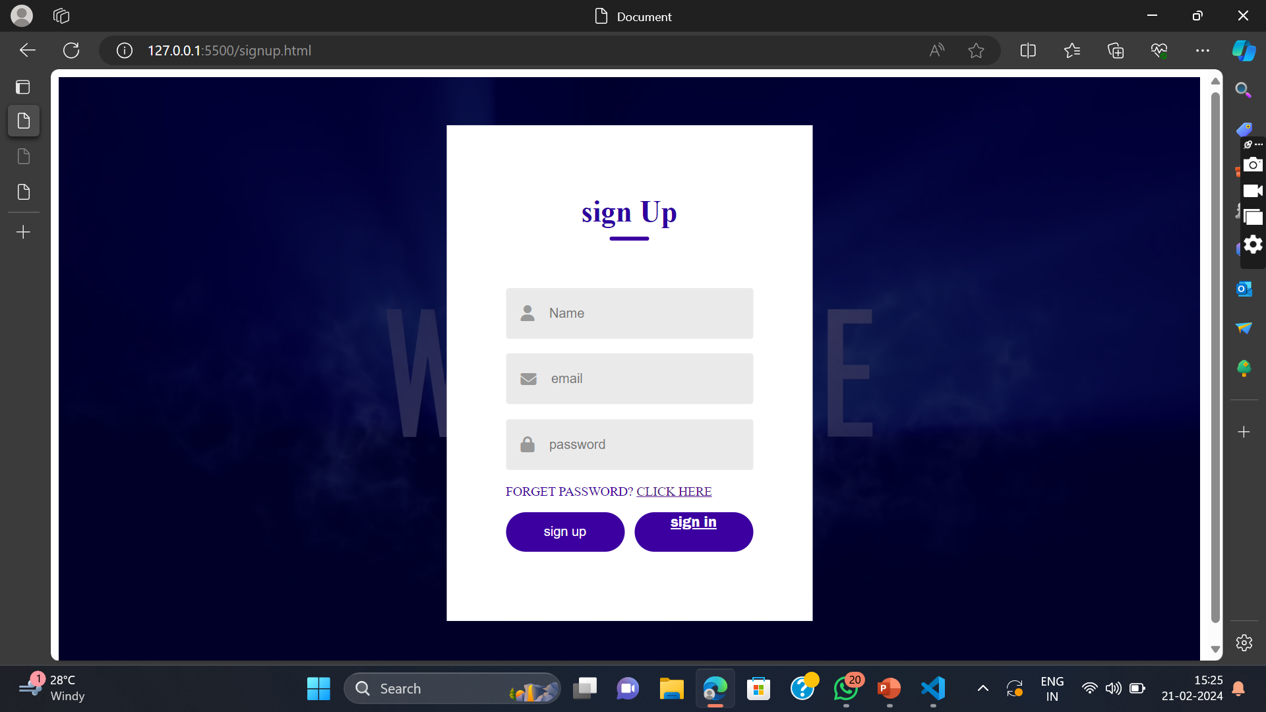
Project Screen shorts

Slide 9
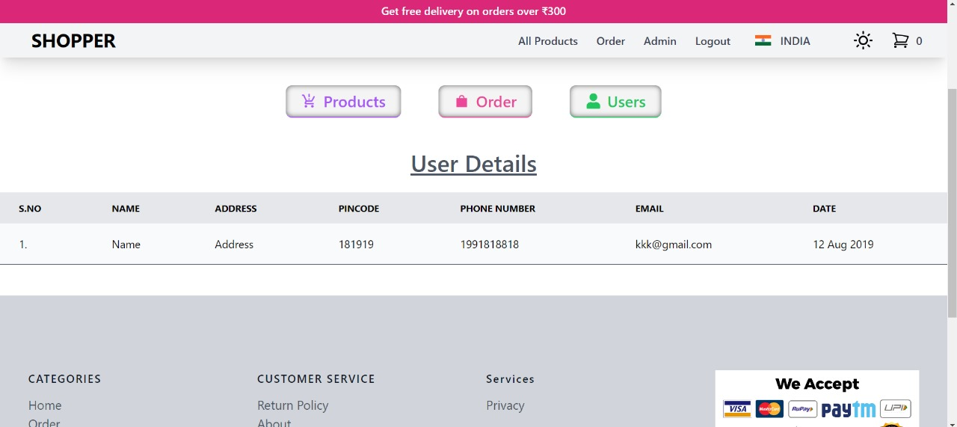
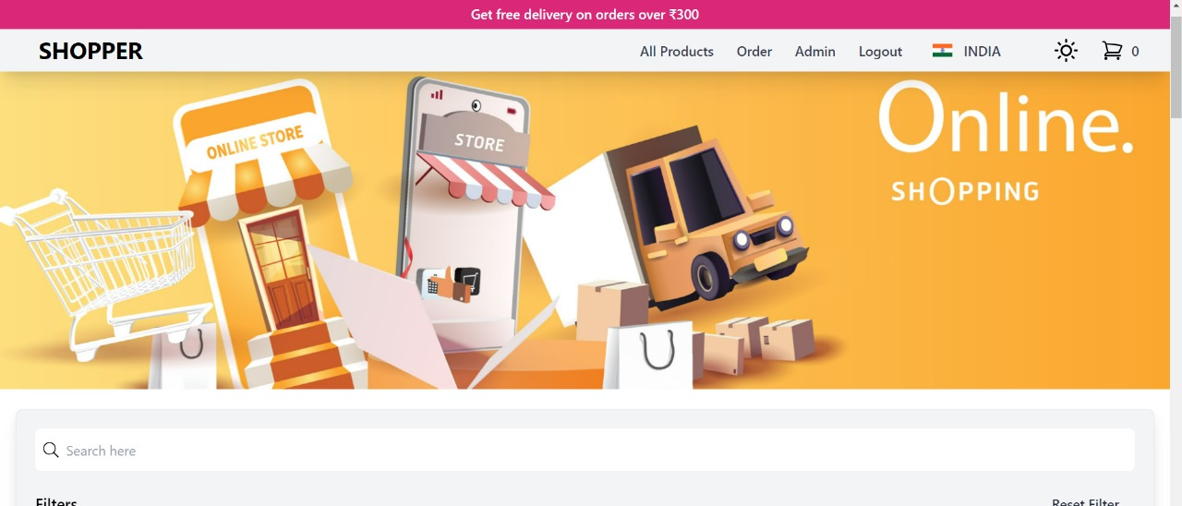
Project Screen shorts
9

Slide 10
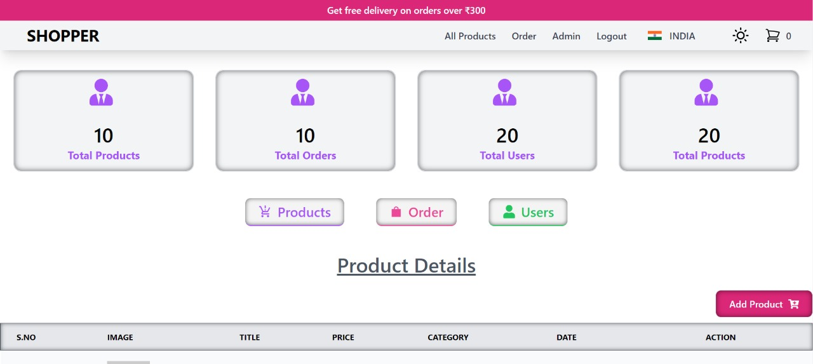
Project Screen shorts
10
10

Slide 11
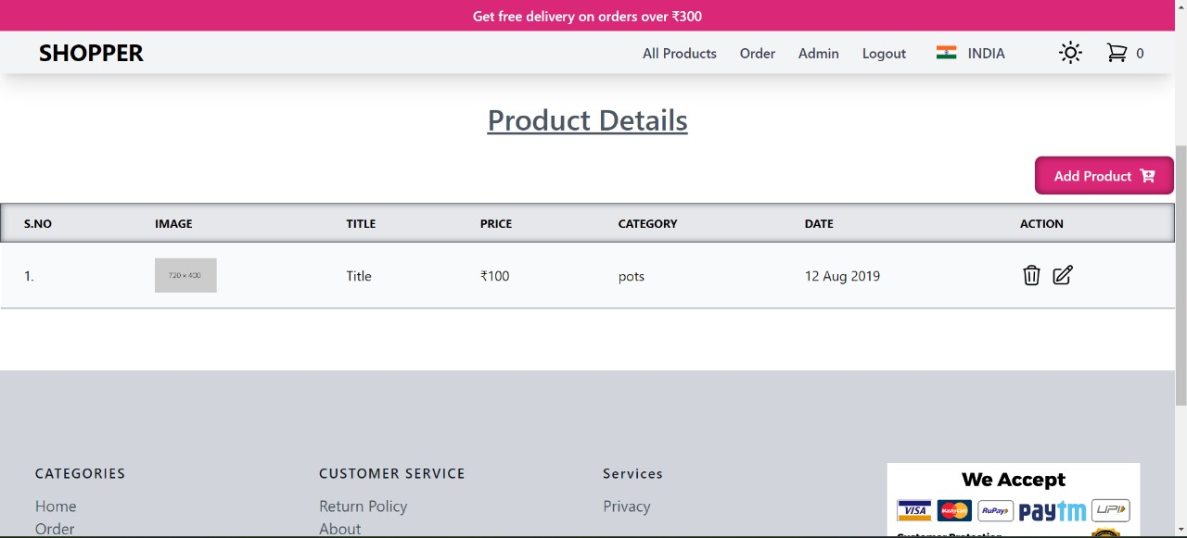
Project Screen shorts
11
11

Slide 12
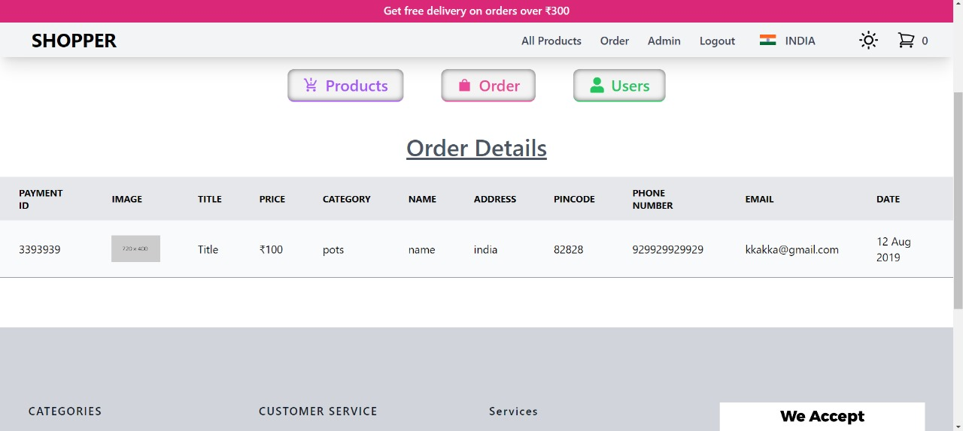
Project Screen shorts
12
12

Slide 13
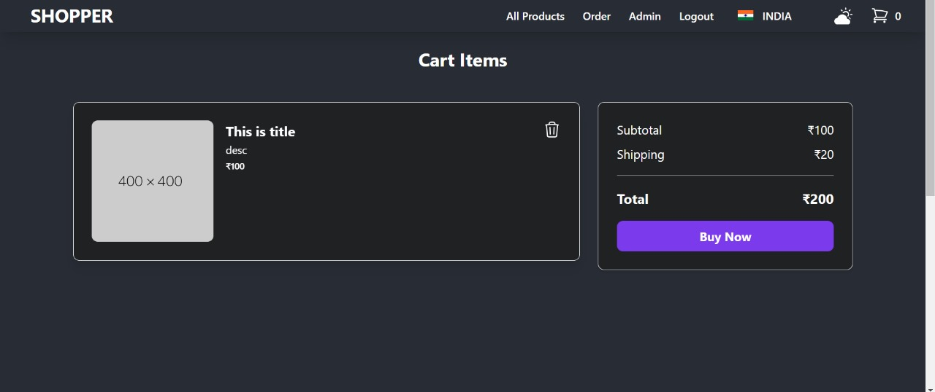
Project Screen shorts
13

Slide 14


